Slide 1
Computer Security:
Principles and Practice
Fourth Edition, Global Edition
By: William Stallings and Lawrie Brown
Notes:
Lecture slides prepared for “Computer Security: Principles and Practice”, 4/e, GE, by William Stallings and Lawrie Brown, Chapter 5 “Database and Data Center Security”.

Slide 2
Chapter 5
Database and
Data Center Security
Notes:
This chapter looks at the unique security issues that relate to databases. The focus
of this chapter is on relational database management systems (RDBMS). The relational
approach dominates industry, government, and research sectors, and is likely
to do so for the foreseeable future. We begin with an overview of the need for database-
specific security techniques. Then we provide a brief introduction to database
management systems, followed by an overview of relational databases. Next, we look
at the issue of database access control, followed by a discussion of the inference
threat. Then, we examine database encryption. Finally, we will examine the security
issues related to the deployment of large data centers.

Slide 3
Database Security
There is a dramatic imbalance between the complexity of modern database management systems (DBMS) and the security technique used to protect these critical systems
Databases have a sophisticated interaction protocol, Structured Query Language (SQL), which is complex
The increasing reliance on cloud technology to host part or all of the corporate database
Reasons database security has not kept pace with the increased reliance on databases are:
Most enterprise environments consist of a heterogeneous mixture of database platforms, enterprise platforms, and OS platforms, creating an additional complexity hurdle for security personnel
Effective database security requires a strategy based on a full understanding of the security vulnerabilities of SQL
The typical organization lacks full-time database security personnel
Notes:
Organizational databases tend to concentrate sensitive information in a single
logical system. Examples include:
• Corporate financial data
• Confidential phone records
• Customer and employee information, such as name, Social Security number,
bank account information, credit card information
• Proprietary product information
• Health care information and medical records
For many businesses and other organizations, it is important to be able to
provide customers, partners, and employees with access to this information. But such
information can be targeted by internal and external threats of misuse or unauthorized
change. Accordingly, security specifically tailored to databases is an increasingly
important component of an overall organizational security strategy.
[BENN06] cites the following reasons why database security has not kept pace
with the increased reliance on databases:
1. There is a dramatic imbalance between the complexity of modern database
management systems (DBMS) and the security techniques used to protect these
critical systems. A DBMS is a very complex, large piece of software, providing
many options, all of which need to be well understood and then secured to avoid
data breaches. Although security techniques have advanced, the increasing
complexity of the DBMS—with many new features and services—has brought
a number of new vulnerabilities and the potential for misuse.
2. Databases have a sophisticated interaction protocol called the Structured Query
Language (SQL), which is far more complex, than for example, the Hypertext
Transfer Protocol (HTTP) used to interact with a Web service. Effective database
security requires a strategy based on a full understanding of the security vulnerabilities
of SQL.
3. The typical organization lacks full-time database security personnel. The result is a
mismatch between requirements and capabilities. Most organizations have a staff
of database administrators, whose job is to manage the database to ensure availability,
performance, correctness, and ease of use. Such administrators may have
limited knowledge of security and little available time to master and apply security
techniques. On the other hand, those responsible for security within an organization
may have very limited understanding of database and DBMS technology.
4. Most enterprise environments consist of a heterogeneous mixture of database
platforms (Oracle, IBM DB2 and Informix, Microsoft, Sybase, etc.), enterprise
platforms (Oracle E-Business Suite, PeopleSoft, SAP, Siebel, etc.), and OS platforms
(UNIX, Linux, z/OS, and Windows, etc.). This creates an additional complexity
hurdle for security personnel.
An additional recent challenge for organizations is their increasing reliance on
cloud technology to host part or all of the corporate database. This adds an additional
burden to the security staff.

Slide 4
Databases
Structured collection of data stored for use by one or more applications
Contains the relationships between data items and groups of data items
Can sometimes contain sensitive data that needs to be secured
Query language
Provides a uniform interface to the database for users and applications
Database management system (DBMS)
Suite of programs for constructing and maintaining the database
Offers ad hoc query facilities to multiple users and applications
Notes:
In some cases, an organization can function with a relatively simple collection of files of
data. Each file may contain text (e.g., copies of memos and reports) or numerical data
(e.g., spreadsheets). A more elaborate file consists of a set of records. However, for an
organization of any appreciable size, a more complex structure known as a database
is required. A database is a structured collection of data stored for use by one or more
applications. In addition to data, a database contains the relationships between data
items and groups of data items. As an example of the distinction between data files
and a database, consider the following. A simple personnel file might consist of a set
of records, one for each employee. Each record gives the employee’s name, address,
date of birth, position, salary, and other details needed by the personnel department.
A personnel database includes a personnel file, as just described. It may also
include a time and attendance file, showing for each week the hours worked by each
employee. With a database organization, these two files are tied together so that a
payroll program can extract the information about time worked and salary for each
employee to generate paychecks.
Accompanying the database is a database management system (DBMS) ,
which is a suite of programs for constructing and maintaining the database and for
offering ad hoc query facilities to multiple users and applications. A query language
provides a uniform interface to the database for users and applications.

Slide 5
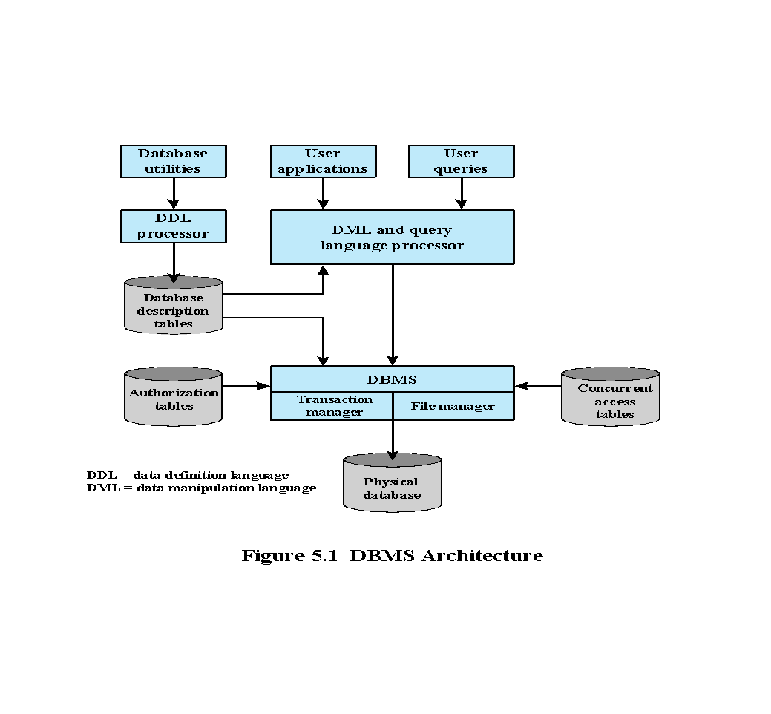
Notes:
Figure 5.1 provides a simplified block diagram of a DBMS architecture. Database
designers and administrators make use of a data definition language (DDL) to define
the database logical structure and procedural properties, which are represented by
a set of database description tables. A data manipulation language (DML) provides
a powerful set of tools for application developers. Query languages are declarative
languages designed to support end users. The database management system makes
use of the database description tables to manage the physical database. The interface
to the database is through a file manager module and a transaction manager module.
In addition to the database description table, two other tables support the DBMS.
The DBMS uses authorization tables to ensure the user has permission to execute
the query language statement on the database. The concurrent access table prevents
conflicts when simultaneous, conflicting commands are executed.
Database systems provide efficient access to large volumes of data and are vital
to the operation of many organizations. Because of their complexity and criticality,
database systems generate security requirements that are beyond the capability of
typical OS-based security mechanisms or stand-alone security packages.
Operating system security mechanisms typically control read and write
access to entire files. So they could be used to allow a user to read or to write any
information in, for example, a personnel file. But they could not be used to limit
access to specific records or fields in that file. A DBMS typically does allow this type
of more detailed access control to be specified. It also usually enables access controls
to be specified over a wider range of commands, such as to select, insert, update, or
delete specified items in the database. Thus, security services and mechanisms are
needed that are designed specifically for, and integrated with, database systems.

Slide 6
Relational Databases
Table of data consisting of rows and columns
Each column holds a particular type of data
Each row contains a specific value for each column
Ideally has one column where all values are unique, forming an identifier/key for that row
Enables the creation of multiple tables linked together by a unique identifier that is present in all tables
Use a relational query language to access the database
Allows the user to request data that fit a given set of criteria
Notes:
The basic building block of a relational database is a table of data, consisting of rows
and columns, similar to a spreadsheet. Each column holds a particular type of data,
while each row contains a specific value for each column. Ideally, the table has at
least one column in which each value is unique, thus serving as an identifier for a
given entry. For example, a typical telephone directory contains one entry for each
subscriber, with columns for name, telephone number, and address. Such a table is
called a flat file because it is a single two-dimensional (rows and columns) file. In a
flat file, all of the data are stored in a single table. For the telephone directory, there
might be a number of subscribers with the same name, but the telephone numbers
should be unique, so that the telephone number serves as a unique identifier for a
row. However, two or more people sharing the same phone number might each be
listed in the directory. To continue to hold all of the data for the telephone directory
in a single table and to provide for a unique identifier for each row, we could require
a separate column for secondary subscriber, tertiary subscriber, and so on. The result
would be that for each telephone number in use, there is a single entry in the table.
The drawback of using a single table is that some of the column positions for
a given row may be blank (not used). Also, any time a new service or new type of
information is incorporated in the database, more columns must be added and the
database and accompanying software must be redesigned and rebuilt.
The relational database structure enables the creation of multiple tables
tied together by a unique identifier that is present in all tables.
Users and applications use a relational query language to access the database.
The query language uses declarative statements rather than the procedural
instructions of a programming language. In essence, the query language allows
the user to request selected items of data from all records that fit a given set of
criteria. The software then figures out how to extract the requested data from one
or more tables. For example, a telephone company representative could retrieve a
subscriber’s billing information as well as the status of special services or the latest
payment received, all displayed on one screen.

Slide 7
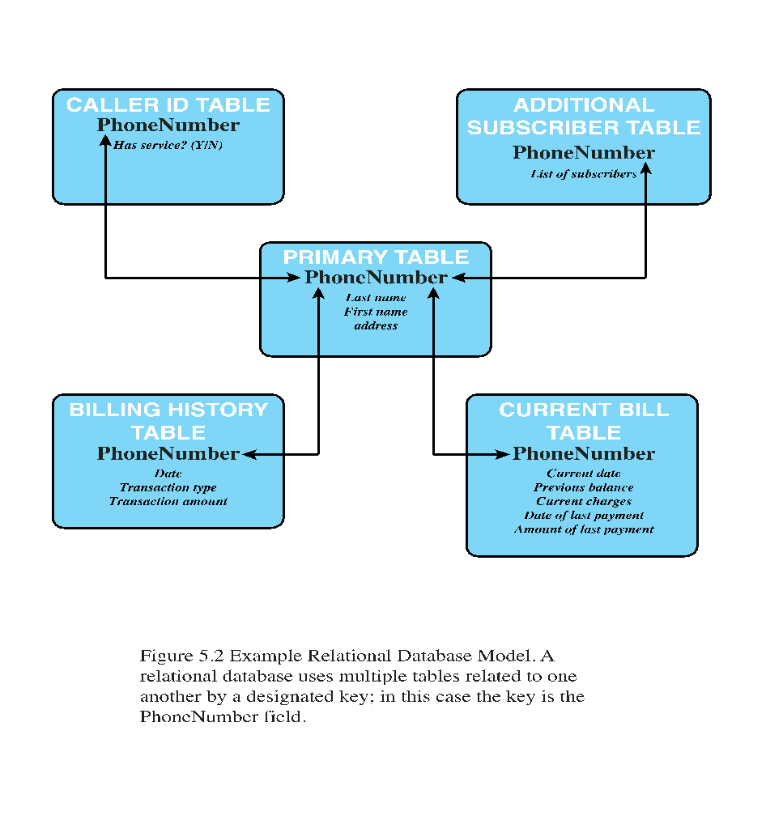
Notes:
Figure 5.2 shows
how new services and features can be added to the telephone database without
reconstructing the main table. In this example, there is a primary table with
basic information for each telephone number. The telephone number serves as
a primary key. The database administrator can then define a new table with a
column for the primary key and other columns for other information.

Slide 8
Relational Database Elements
Primary key
Relation
Table/file
Tuple
Row/record
Attribute
Column/field
Uniquely identifies a row
Consists of one or more column names
Foreign key
Links one table to attributes in another
View/virtual table
Result of a query that returns selected rows and columns from one or more tables
Views are often used for security purposes
Notes:
In relational database parlance, the basic building block is a relation , which is a
flat table. Rows are referred to as tuples , and columns are referred to as attributes
A primary key is defined to be a portion of a row used to uniquely
identify a row in a table; the primary key consists of one or more column names.
In the example of Figure 5.2 , a single attribute, PhoneNumber, is sufficient to
uniquely identify a row in a particular table.
To create a relationship between two tables, the attributes that define the
primary key in one table must appear as attributes in another table, where they are
referred to as a foreign key . Whereas the value of a primary key must be unique
for each tuple (row) of its table, a foreign key value can appear multiple times in
a table, so that there is a one-to-many relationship between a row in the table with
the primary key and rows in the table with the foreign key.
A view is a virtual table. In essence, a view is the result of a query that returns
selected rows and columns from one or more tables.
Views are often used for security purposes. A view can provide restricted access to a
relational database so that a user or application only has access to certain rows or columns.

Slide 9

Table 5.1
Basic Terminology for Relational Databases
Notes:
Basic Terminology for Relational Databases

Slide 10
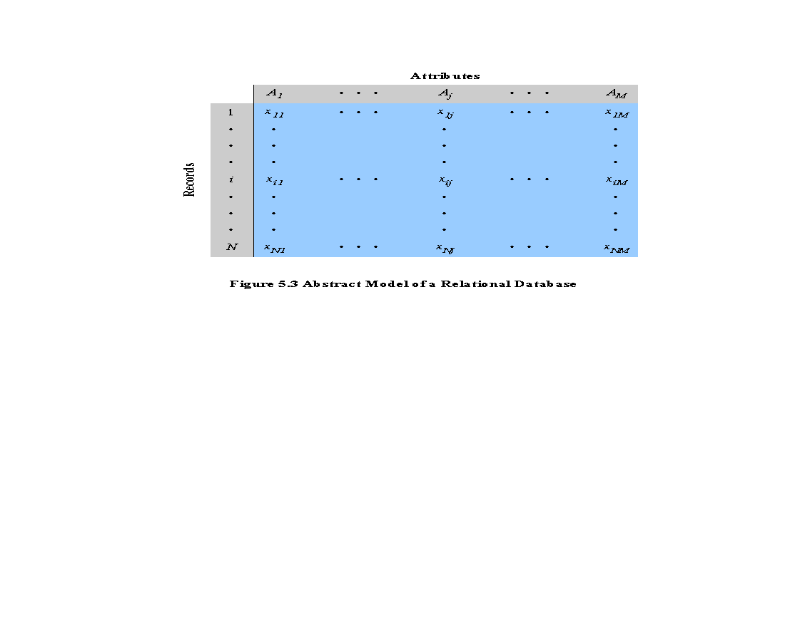
Notes:
An abstract model of a relational database
table is shown as Figure 5.3. There are N individuals, or entities, in the table
and M attributes. Each attribute A_{j} has |A_{j} | possible values, with x_{ij} denoting the
value of attribute j for entity i .

Slide 11
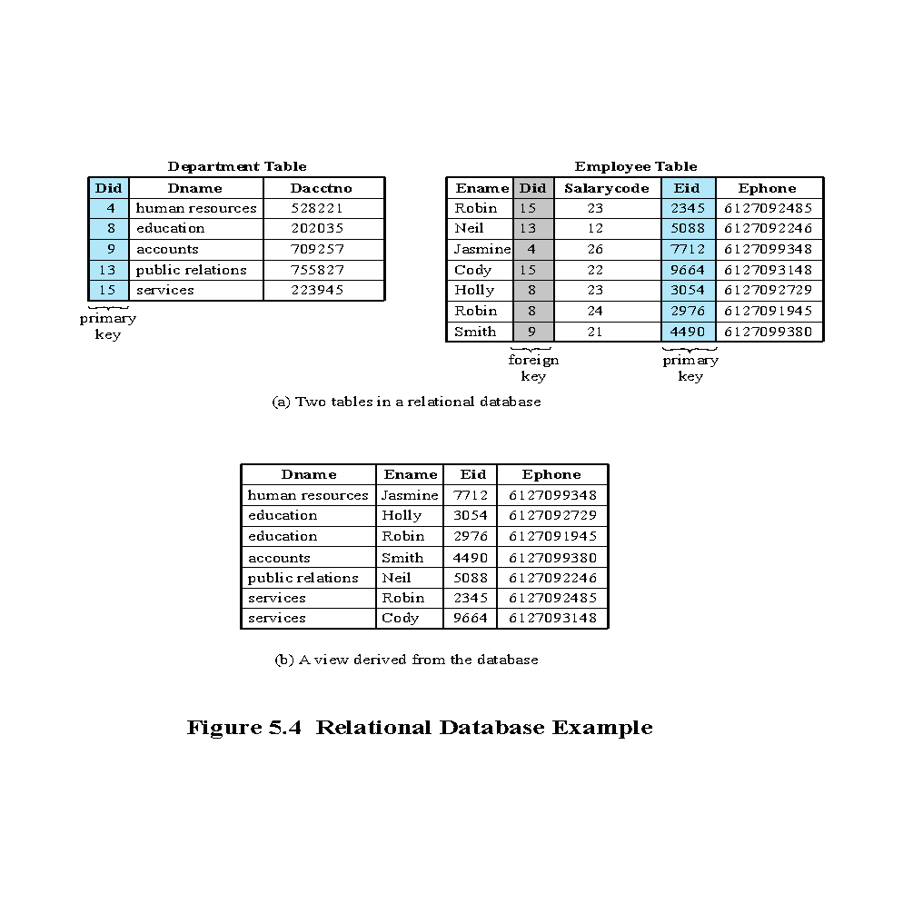
Notes:
Figure 5.4a provides a relational database example.In the Department table, the
department ID (Did) is the primary key;
each value is unique. This table gives the ID, name, and account number for each
department. The Employee table contains the name, salary code, employee ID, and
phone number of each employee. The Employee table also indicates the department
to which each employee is assigned by including Did. Did is identified as a foreign key
and provides the relationship between the Employee table and the Department table.
A view is a virtual table. In essence, a view is the result of a query that returns
selected rows and columns from one or more tables.
Figure 5.4b is a view that
includes the employee name, ID, and phone number from the Employee table and
the corresponding department name from the Department table. The linkage is the
Did , so that the view table includes data from each row of the Employee table, with
additional data from the Department table. It is also possible to construct a view
from a single table. For example, one view of the Employee table consists of all
rows, with the salary code column deleted. A view can be qualified to include only
some rows and/or some columns. For example, a view can be defined consisting of
all rows in the Employee table for which the Did = 15.

Slide 12
Structured Query Language (SQL)
Standardized language to define schema, manipulate, and query data in a relational database
Several similar versions of ANSI/ISO standard
All follow the same basic syntax and semantics
SQL statements can be used to:
Create tables
Insert and delete data in tables
Create views
Retrieve data with query statements
Notes:
Structured Query Language (SQL) is a standardized language that can be used to
define schema, manipulate, and query data in a relational database. There are several
versions of the ANSI/ISO standard and a variety of different implementations,
but all follow the same basic syntax and semantics.
SQL statements
can be used to create tables, insert and delete data in tables, create views, and
retrieve data with query statements.

Slide 13
SQL Injection Attacks (SQLi)
One of the most prevalent and dangerous network-based security threats
Designed to exploit the nature of Web application pages
Sends malicious SQL commands to the database server
Most common attack goal is bulk extraction of data
Depending on the environment SQL injection can also be exploited to:
Modify or delete data
Execute arbitrary operating system commands
Launch denial-of-service (DoS) attacks
Notes:
The SQL injection (SQLi) attack is one of the most prevalent and dangerous
network-based security threats. Consider the following reports:
1. The July 2013 Imperva Web Application Attack Report [IMPE13] surveyed a
cross-section of Web application servers in industry and monitored eight different
types of common attacks. The report found that SQLi attacks ranked
first or second in total number of attack incidents, the number of attack
requests per attack incident, and average number of days per month that an
application experienced at least one attack incident. Imperva observed a single
Web site that received 94,057 SQL injection attack requests in one day.
2. The Open Web Application Security Project’s 2013 report [OWAS13] on the
ten most critical Web application security risks listed injection attacks, especially
SQLi attacks, as the top risk. This ranking is unchanged from its 2010 report.
3. The Veracode 2016 State of Software Security Report [VERA16] found that
percentage of applications affected by SQLi attacks is around 35%.
4. The Trustwave 2016 Global Security Report [TRUS16] lists SQLi attacks as
one of the top two intrusion techniques. The report notes that SQLi can pose a
significant threat to sensitive data such as personally identifiable information
(PII) and credit card data, and it can be hard to prevent and relatively easy to
exploit these attacks.
In general terms, an SQLi attack is designed to exploit the nature of Web application
pages. In contrast to the static Web pages of years gone by, most current Web sites
have dynamic components and content. Many such pages ask for information, such
as location, personal identity information, and credit card information. This dynamic
content is usually transferred to and from back-end databases that contain volumes of
information—anything from cardholder data to which type of running shoes is most
purchased. An application server Web page will make SQL queries to databases to
send and receive information critical to making a positive user experience.
In such an environment, an SQLi attack is designed to send malicious SQL
commands to the database server. The most common attack goal is bulk extraction
of data. Attackers can dump database tables with hundreds of thousands of customer
records. Depending on the environment, SQL injection can also be exploited
to modify or delete data, execute arbitrary operating system commands, or launch
denial-of-service (DoS) attacks.

Slide 14
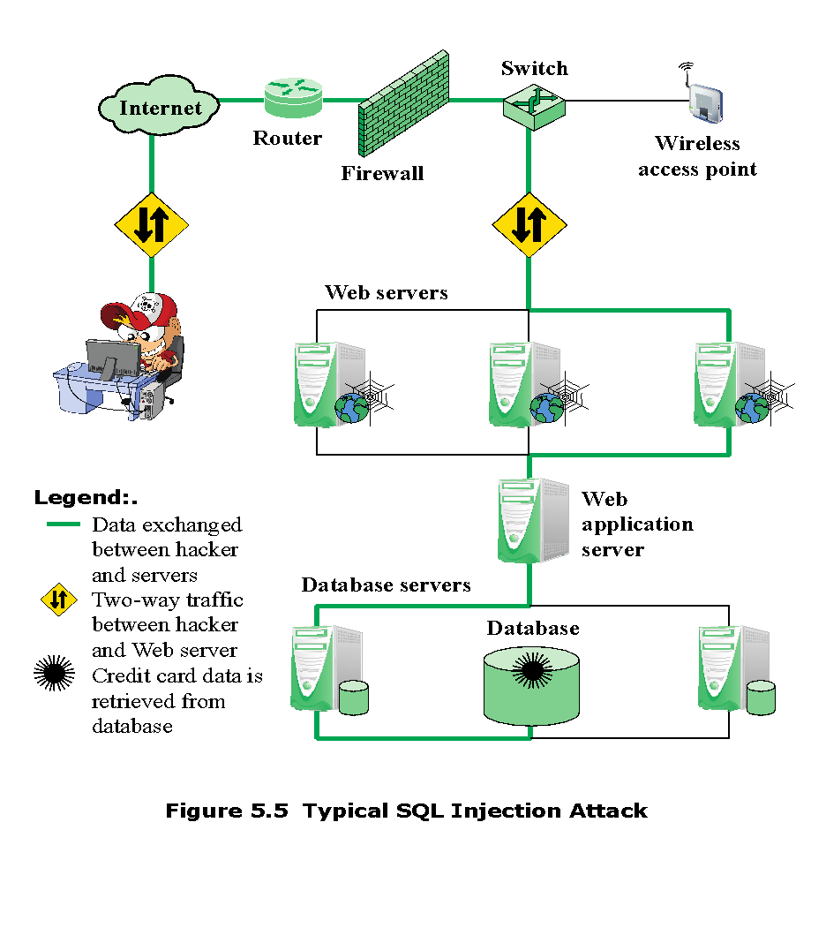
Notes:
SQLi is an attack that exploits a security vulnerability occurring in the database layer
of an application (such as queries). Using SQL injection, the attacker can extract or
manipulate the web application’s data. The attack is viable when user input is either
incorrectly filtered for string literal escape characters embedded in SQL statements
or user input is not strongly typed, and thereby unexpectedly executed.
Figure 5.5, from [ACUN13], is a typical example of an SQLi attack. The steps
involved are as follows:
1. Hacker finds a vulnerability in a custom Web application and injects an SQL
command to a database by sending the command to the Web server. The command
is injected into traffic that will be accepted by the firewall.
2. The Web server receives the malicious code and sends it to the Web application
server.
3. The Web application server receives the malicious code from the Web server
and sends it to the database server.
4. The database server executes the malicious code on the database. The database
returns data from credit cards table.
5. The Web application server dynamically generates a page with data including
credit card details from the database.
6. The Web server sends the credit card details to the hacker.

Slide 15
Injection Technique
The SQLi attack typically works by prematurely terminating a text string and appending a new command
Because the inserted command may have additional strings appended to it before it is executed the attacker terminates the injected string with a comment mark “- -”
Subsequent text is ignored at execution time
Notes:
The SQLi attack typically works by prematurely terminating a text string and
appending a new command. Because the inserted command may have additional
strings appended to it before it is executed, the attacker terminates the injected
string with a comment mark “--”. Subsequent text is ignored at execution time.

Slide 16
Inband Attacks
Uses the same communication channel for injecting SQL code and retrieving results
The retrieved data are presented directly in application Web page
Include:
Tautology
End-of-line comment
Piggybacked queries
This form of attack injects code in one or more conditional statements so that they always evaluate to true
After injecting code into a particular field, legitimate code that follows are nullified through usage of end of line comments
The attacker adds additional queries beyond the intended query, piggy-backing the attack on top of a legitimate request
Notes:
Attack types can be grouped into three main categories: inband, inferential,
and out-of-band. An inband attack uses the same communication channel for injecting
SQL code and retrieving results. The retrieved data are presented directly in the
application Web page. Inband attack types include the following:
• Tautology: This form of attack injects code in one or more conditional statements
so that they always evaluate to true.
• End-of-line comment: After injecting code into a particular field, legitimate code
that follows are nullified through usage of end of line comments. An example
would be to add ”- -” after inputs so that remaining queries are not treated as executable
code, but comments. The preceding tautology example is also of this form.
• Piggybacked queries: The attacker adds additional queries beyond the intended
query, piggy-backing the attack on top of a legitimate request. This technique
relies on server configurations that allow several different queries within a single
string of code. The example in the preceding section is of this form.

Slide 17
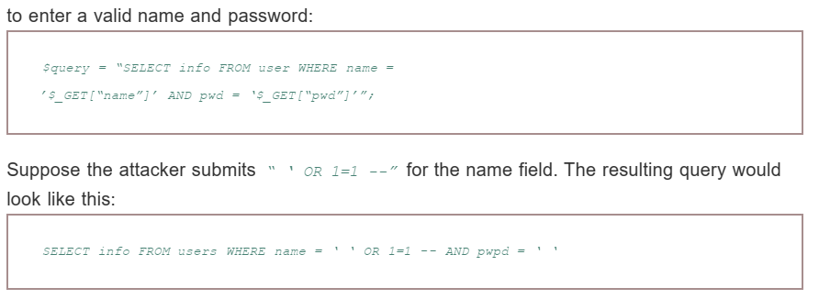

Slide 18
Inferential Attack
There is no actual transfer of data, but the attacker is able to reconstruct the information by sending particular requests and observing the resulting behavior of the Website/database server
Include:
Illegal/logically incorrect queries
This attack lets an attacker gather important information about the type and structure of the backend database of a Web application
The attack is considered a preliminary, information-gathering step for other attacks
Blind SQL injection
Allows attackers to infer the data present in a database system even when the system is sufficiently secure to not display any erroneous information back to the attacker
Notes:
With an inferential attack , there is no actual transfer of data, but the attacker
is able to reconstruct the information by sending particular requests and observing
the resulting behavior of the Website/database server. Inferential attack types
include the following:
• Illegal/logically incorrect queries: This attack lets an attacker gather important
information about the type and structure of the backend database of a Web
application. The attack is considered a preliminary, information-gathering
step for other attacks. The vulnerability leveraged by this attack is that the
default error page returned by application servers is often overly descriptive.
In fact, the simple fact that an error messages is generated can often reveal
vulnerable/injectable parameters to an attacker.
• Blind SQL injection: Blind SQL injection allows attackers to infer the data
present in a database system even when the system is sufficiently secure to not
display any erroneous information back to the attacker. The attacker asks the
server true/false questions. If the injected statement evaluates to true, the site
continues to function normally. If the statement evaluates to false, although
there is no descriptive error message, the page differs significantly from the
normally functioning page.

Slide 19
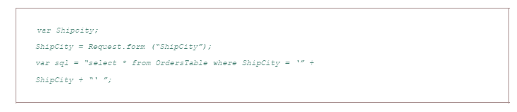

Slide 20
SQLi Countermeasures
Three types:
Detection
Manual defensive coding practices
Parameterized query insertion
Check queries at runtime to see if they conform to a model of expected queries
Signature based
Anomaly based
Code analysis
Defensive coding
Run-time prevention
Notes:
Because SQLi attacks are so prevalent, damaging, and varied both by attack avenue and
type, a single countermeasure is insufficient. Rather an integrated set of techniques
is necessary. In this section, we provide a brief overview of the types of countermeasures
that are in use or being researched, using the classification in [SHAR13].
These countermeasures can be classified into three types: defensive coding, detection,
and run-time prevention.
Many SQLi attacks succeed because developers have used insecure coding
practices. Thus, defensive coding is an effective way to dramatically reduce the
threat from SQLi. Examples of defensive coding include the following:
• Manual defensive coding practices: A common vulnerability exploited by
SQLi attacks is insufficient input validation. The straightforward solution for
eliminating these vulnerabilities is to apply suitable defensive coding practices.
An example is input type checking, to check that inputs that are supposed to
be numeric contain no characters other than digits. This type of technique
can avoid attacks based on forcing errors in the database management system.
Another type of coding practice is one that performs pattern matching to try
to distinguish normal input from abnormal input.
• Parameterized query insertion: This approach attempts to prevent SQLi by
allowing the application developer to more accurately specify the structure
of an SQL query, and pass the value parameters to it separately such that any
unsanitary user input is not allowed to modify the query structure.
• SQL DOM: SQL DOM is a set of classes that enables automated data type
validation and escaping [MCCL05]. This approach uses encapsulation of
database queries to provide a safe and reliable way to access databases. This
changes the query-building process from an unregulated one that uses string
concatenation to a systematic one that uses a type-checked API. Within the
API, developers are able to systematically apply coding best practices such as
input filtering and rigorous type checking of user input.
A variety of detection methods have been developed, including the following:
• Signature based: This technique attempts to match specific attack patterns.
Such an approach must be constantly updated and may not work against self-modifying
attacks.
• Anomaly based: This approach attempts to define normal behavior and then
detect behavior patterns outside the normal range. A number of approaches
have been used. In general terms, there is a training phase, in which the system
learns the range of normal behavior, followed by the actual detection phase.
• Code analysis: Code analysis techniques involve the use of a test suite to
detect SQLi vulnerabilities. The test suite is designed to generate a wide range
of SQLi attacks and assess the response of the system.
Finally, a number of run-time prevention techniques have been developed as
SQLi countermeasures. These techniques check queries at runtime to see if they
conform to a model of expected queries. Various automated tools are available for
this purpose [CHAN11, SHAR13].

Slide 21
$username = $_POST['username'];
$password = $_POST['password'];
$query = "SELECT * FROM users WHERE username='$username' AND password='$password'";
$result = mysqli_query($connection, $query);

Slide 22
Database Access Control
Database access control system determines:
Can support a range of administrative policies
If the user has access to the entire database or just portions of it
Centralized administration
Small number of privileged users may grant and revoke access rights
What access rights the user has (create, insert, delete, update, read, write)
Ownership-based administration
The creator of a table may grant and revoke access rights to the table
Decentralized administration
The owner of the table may grant and revoke authorization rights to other users, allowing them to grant and revoke access rights to the table
Notes:
Commercial and open-source DBMSs typically provide an access control capability
for the database. The DBMS operates on the assumption that the computer system
has authenticated each user. As an additional line of defense, the computer system
may use the overall access control system described in Chapter 4 to determine
whether a user may have access to the database as a whole. For users who are
authenticated and granted access to the database, a database access control system
provides a specific capability that controls access to portions of the database.
Commercial and open-source DBMSs provide discretionary or role-based
access control. We defer a discussion of mandatory access control considerations
to Chapter 27 . Typically, a DBMS can support a range of administrative policies,
including the following:
• Centralized administration: A small number of privileged users may grant and
revoke access rights.
• Ownership-based administration: The owner (creator) of a table may grant
and revoke access rights to the table.
• Decentralized administration: In addition to granting and revoking access rights
to a table, the owner of the table may grant and revoke authorization rights to
other users, allowing them to grant and revoke access rights to the table.
As with any access control system, a database access control system distinguishes
different access rights, including create, insert, delete, update, read, and write. Some
DBMSs provide considerable control over the granularity of access rights. Access
rights can be to the entire database, to individual tables, or to selected rows or columns
within a table. Access rights can be determined based on the contents of a table entry.
For example, in a personnel database, some users may be limited to seeing salary
information only up to a certain maximum value. And a department manager may
only be allowed to view salary information for employees in his or her department.

Slide 23
SQL Access Controls
Two commands for managing access rights:
Grant
Used to grant one or more access rights or can be used to assign a user to a role
Revoke
Revokes the access rights
Typical access rights are:
Select
Insert
Update
Delete
References
Notes:
SQL provides two commands for managing access rights, GRANT and REVOKE.
For different versions of SQL, the syntax is slightly different. In general terms, the
GRANT command has the following syntax:
GRANT { privileges | role }
[ON table]
TO { user | role | PUBLIC }
[IDENTIFIED BY password]
[WITH GRANT OPTION]
This command can be used to grant one or more access rights or can be used
to assign a user to a role. For access rights, the command can optionally specify that
it applies only to a specified table. The TO clause specifies the user or role to which
the rights are granted. A PUBLIC value indicates that any user has the specified
access rights. The optional IDENTIFIED BY clause specifies a password that
must be used to revoke the access rights of this GRANT command. The GRANT
OPTION indicates that the grantee can grant this access right to other users, with or
without the grant option.
As a simple example, consider the following statement.
GRANT SELECT ON ANY TABLE TO ricflair
This statement enables user ricflair to query any table in the database.
Different implementations of SQL provide different ranges of access rights.
The following is a typical list:
• Select: Grantee may read entire database; individual tables; or specific
columns in a table.
• Insert: Grantee may insert rows in a table; or insert rows with values for specific
columns in a table.
• Update: Semantics is similar to INSERT.
• Delete: Grantee may delete rows from a table.
• References: Grantee is allowed to define foreign keys in another table that
refer to the specified columns.
The REVOKE command has the following syntax:
REVOKE { privileges | role }
[ON table]
FROM { user | role | PUBLIC }
Thus, the following statement revokes the access rights of the preceding example:
REVOKE SELECT ON ANY TABLE FROM ricflair

Slide 24
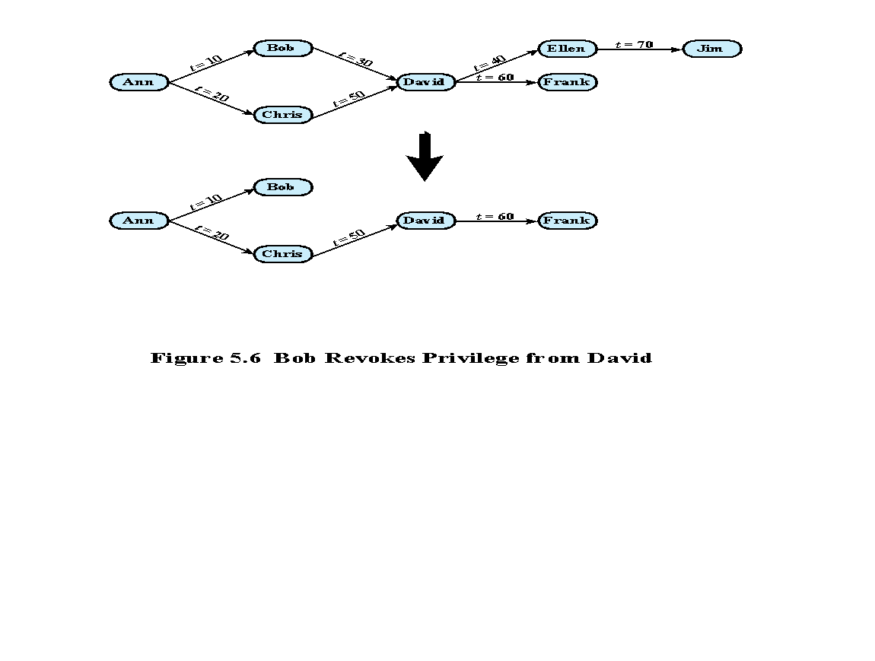
Notes:
The grant option enables an access right to cascade through a number of users.We
consider a specific access right and illustrate the cascade phenomenonin Figure 5.6 .
The figure indicates that Ann grants the access right to Bob at time t = 10 and to
Chris at time t = 20. Assume that the grant option is always used. Thus, Bob is able
to grant the access right to David at t = 30. Chris redundantly grants the access right
to David at t = 50. Meanwhile, David grants the right to Ellen, who in turn grants it
to Jim; and subsequently David grants the right to Frank.
Just as the granting of privileges cascades from one user to another using
the grant option, the revocation of privileges also cascaded. Thus, if Ann
revokes the access right to Bob and Chris, then the access right is also revoked
to David, Ellen, Jim, and Frank. A complication arises when a user receives the
same access right multiple times, as happens in the case of David. Suppose that
Bob revokes the privilege from David. David still has the access right because
it was granted by Chris at t = 50. However, David granted the access right to
Ellen after receiving the right, with grant option, from Bob but prior to receiving
it from Chris. Most implementations dictate that in this circumstance, the access
right to Ellen and therefore Jim is revoked when Bob revokes the access right
to David. This is because at t = 40, when David granted the access right to
Ellen, David only had the grant option to do this from Bob. When Bob revokes
the right, this causes all subsequent cascaded grants that are traceable solely
to Bob via David to be revoked. Because David granted the access right
to Frank after David was granted the access right with grant option from Chris,
the access right to Frank remains. These effects are shown in the lower portion of
Figure 5.6 .
To generalize, the convention followed by most implementations is as follows.
When user A revokes an access right, any cascaded access right is also revoked,
unless that access right would exist even if the original grant from A had never
occurred. This convention was first proposed in [GRIF76].

Slide 25
Role-Based Access Control (RBAC)
Role-based access control eases administrative burden and improves security
A database RBAC needs to provide the following capabilities:
Create and delete roles
Define permissions for a role
Assign and cancel assignment of users to roles
Categories of database users:
Application owner
End user
Administrator
An end user who owns database objects as part of an application
An end user who operates on database objects via a particular application but does not own any of the database objects
User who has administrative responsibility for part or all of the database
Notes:
A role-based access control (RBAC) scheme is a natural fit for database access
control. Unlike a file system associated with a single or a few applications, a
database system often supports dozens of applications. In such an environment,
an individual user may use a variety of applications to perform a variety of tasks,
each of which requires its own set of privileges. It would be poor administrative
practice to simply grant users all of the access rights they require for all the tasks
they perform. RBAC provides a means of easing the administrative burden and
improving security.
In a discretionary access control environment, we can classify database users
in three broad categories:
• Application owner: An end user who owns database objects (tables, columns,
rows) as part of an application. That is, the database objects are generated by
the application or are prepared for use by the application.
End user other than application owner: An end user who operates on database
objects via a particular application but does not own any of the database objects.
• Administrator: User who has administrative responsibility for part or all of the
database.
We can make some general statements about RBAC concerning these
three types of users. An application has associated with it a number of tasks,
with each task requiring specific access rights to portions of the database.
For each task, one or more roles can be defined that specify the needed access
rights. The application owner may assign roles to end users. Administrators are
responsible for more sensitive or general roles, including those having to do
with managing physical and logical database components, such as data files,
users, and security mechanisms. The system needs to be set up to give certain
administrators certain privileges. Administrators in turn can assign users to
administrative-related roles.
A database RBAC facility needs to provide the following capabilities:
• Create and delete roles.
• Define permissions for a role.
• Assign and cancel assignment of users to roles.

Slide 26
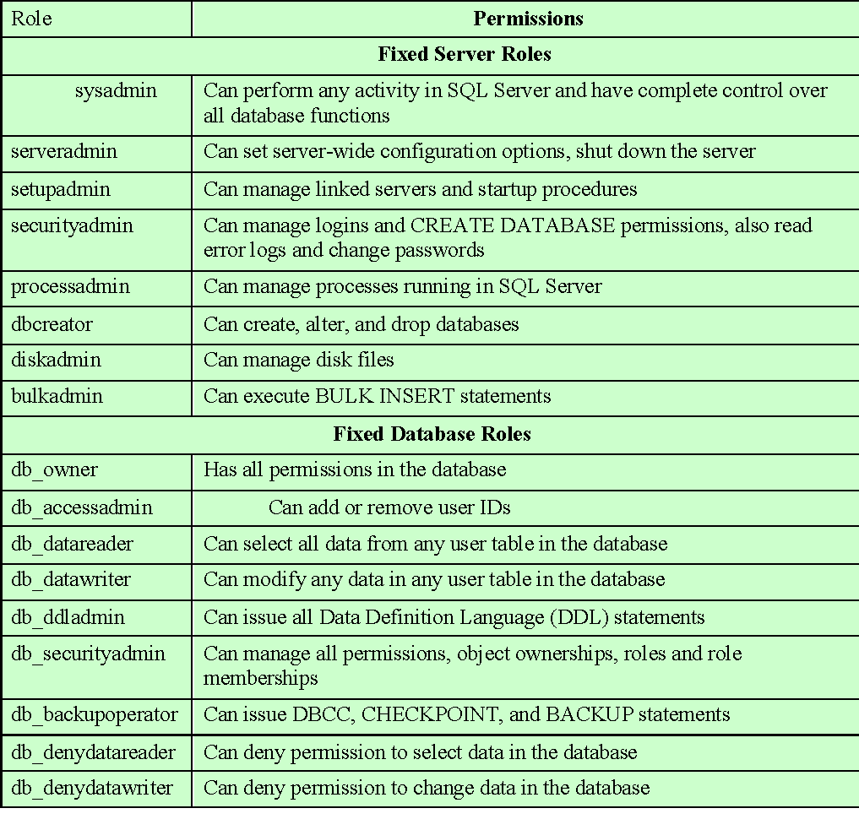
Table 5.2
Fixed
Roles
in
Microsoft
SQL
Server
(Table is on page 165 in the textbook)
Notes:
A good example of the use of roles in database security is the RBAC
facility provided by Microsoft SQL Server. SQL Server supports three types of
roles: server roles, database roles, and user-defined roles. The first two types
of roles are referred to as fixed roles ( Table 5.2 ); these are preconfigured for a
system with specific access rights. The administrator or user cannot add, delete,
or modify fixed roles; it is only possible to add and remove users as members of
a fixed role.
Fixed server roles are defined at the server level and exist independently
of any user database. They are designed to ease the administrative task.
These roles have different permissions and are intended to provide the ability
to spread the administrative responsibilities without having to give out complete
control. Database administrators can use these fixed server roles to assign
different administrative tasks to personnel and give them only the rights they
absolutely need.
Fixed database roles operate at the level of an individual database. As with
fixed server roles, some of the fixed database roles, such as db_accessadmin and
db_securityadmin, are designed to assist a DBA with delegating administrative
responsibilities. Others, such as db_datareader and db_datawriter, are designed to
provide blanket permissions for an end user.
SQL Server allows users to create roles. These user-defined roles can
then be assigned access rights to portions of the database. A user with proper
authorization (typically, a user assigned to the db_securityadmin role) may
define a new role and associate access rights with the role. There are two
types of user-defined roles: standard and application. For a standard role,
an authorized user can assign other users to the role. An application role is
associated with an application rather than with a group of users and requires
a password. The role is activated when an application executes the appropriate
code. A user who has access to the application can use the application role for
database access. Often database applications enforce their own security based on
the application logic. For example, you can use an application role with its own
password to allow the particular user to obtain and modify any data only during
specific hours. Thus, you can realize more complex security management within
the application logic.

Slide 27
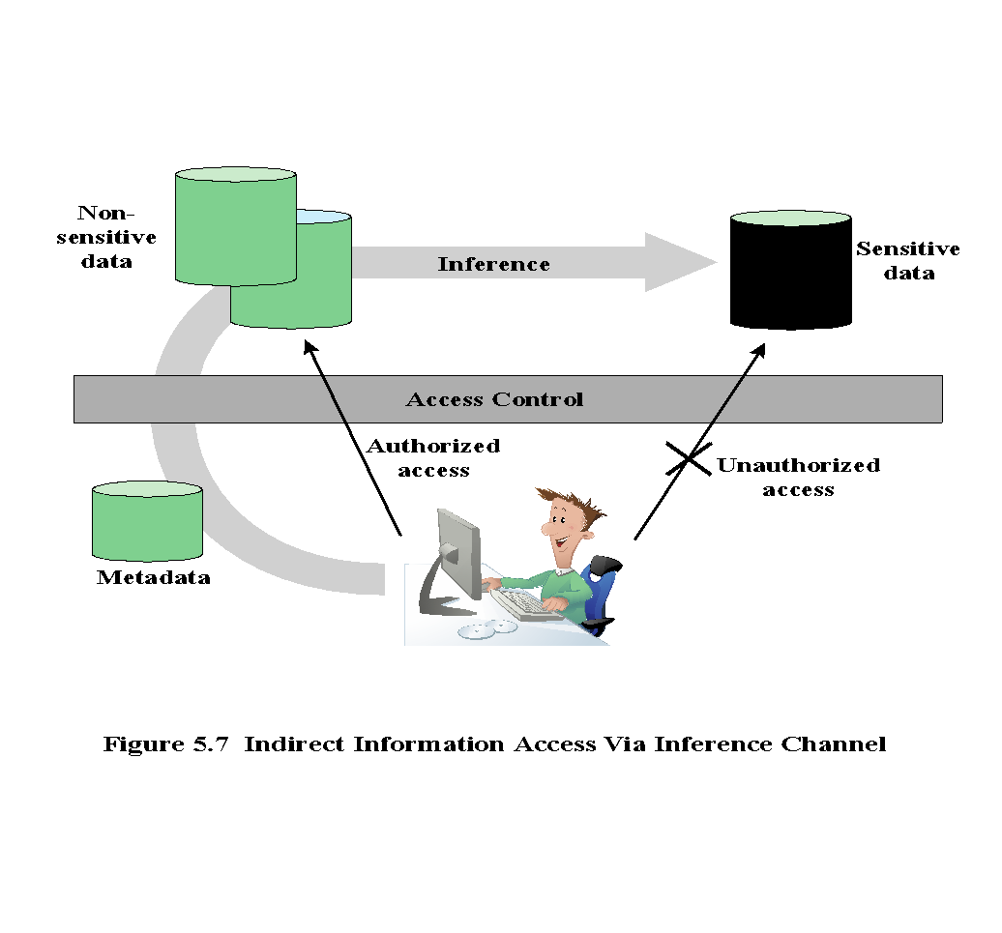
Notes:
Inference, as it relates to database security, is the process of performing authorized
queries and deducing unauthorized information from the legitimate responses
received. The inference problem arises when the combination of a number of
data items is more sensitive than the individual items, or when a combination of
data items can be used to infer data of a higher sensitivity. Figure 5.7 illustrates
the process. The attacker may make use of nonsensitive data as well as metadata.
Metadata refers to knowledge about correlations or dependencies among data
items that can be used to deduce information not otherwise available to a
particular user. The information transfer path by which unauthorized data is
obtained is referred to as an inference channel .

Slide 28
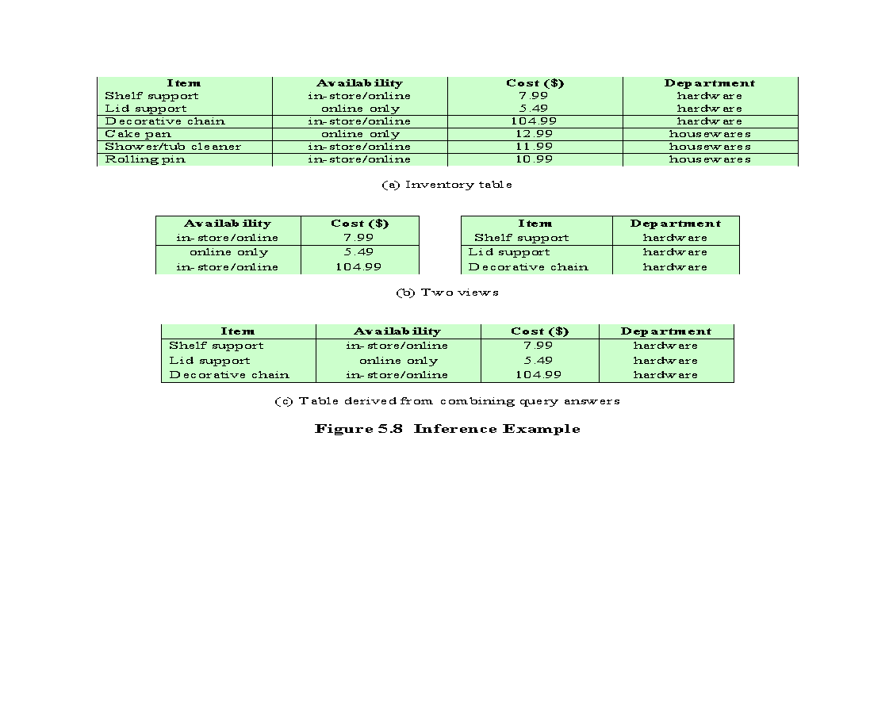
Notes:
In general terms, two inference techniques can be used to derive additional
information: analyzing functional dependencies between attributes within a table
or across tables, and merging views with the same constraints.
An example of the latter shown in Figure 5.8 , illustrates
the inference problem.
Users of these views are not authorized to access the relationship between
Item and Cost. A user who has access to either or both views cannot infer
the relationship by functional dependencies. That is, there is not a functional
relationship between Item and Cost such that knowing Item and perhaps other
information is sufficient to deduce Cost. However, suppose the two views
are created with the access constraint that Item and Cost cannot be accessed
together. A user who knows the structure of the Inventory table and who knows
that the view tables maintain the same row order as the Inventory table is then
able to merge the two views to construct the table shown in Figure 5.8c. This
violates the access control policy that the relationship of attributes Item and
Cost must not be disclosed.

Slide 29
Inference Detection
Approach removes an inference channel by altering the database structure or by changing the access control regime to prevent inference
Inference detection
during database design
Techniques in this category often result in unnecessarily stricter access controls that reduce availability
Two approaches
Approach seeks to eliminate an inference channel violation during a query or series of queries
Inference detection
at query time
If an inference channel is detected, the query is denied or altered
Some inference detection algorithm is needed for either of these approaches
Progress has been made in devising specific inference detection techniques for multilevel secure databases and statistical databases
Notes:
In general terms, there are two approaches to dealing with the threat of
disclosure by inference:
• Inference detection during database design: This approach removes an
inference channel by altering the database structure or by changing the
access control regime to prevent inference. Examples include removing
data dependencies by splitting a table into multiple tables or using more
fine-grained access control roles in an RBAC scheme. Techniques in
this category often result in unnecessarily stricter access controls that
reduce availability.
• Inference detection at query time: This approach seeks to eliminate an
inference channel violation during a query or series of queries. If an inference
channel is detected, the query is denied or altered.
For either of the preceding approaches, some inference detection
algorithm is needed. This is a difficult problem and the subject of ongoing
research. To give some appreciation of the difficulty, we present an example
taken from [LUNT89]. Consider a database containing personnel information,
including names, addresses, and salaries of employees. Individually, the name,
address, and salary information is available to a subordinate role, such as
Clerk, but the association of names and salaries is restricted to a superior role,
such as Administrator. This is similar to the problem illustrated in Figure 5.8.
One solution to this problem is to construct three tables, which include the
following information:
Employees (Emp#, Name, Address)
Salaries (S#, Salary)
Emp-Salary (Emp#, S#)
where each line consists of the table name followed by a list of column names for that
table. In this case, each employee is assigned a unique employee number (Emp#)
and a unique salary number (S#). The Employees table and the Salaries table
are accessible to the Clerk role, but the Emp-Salary table is only available to the
Administrator role. In this structure, the sensitive relationship between employees
and salaries is protected from users assigned the Clerk role. Now suppose that we
want to add a new attribute, employee start date, which is not sensitive. This could
be added to the Salaries table as follows:
Employees (Emp#, Name, Address)
Salaries (S#, Salary, Start-Date)
Emp-Salary (Emp#, S#)
However, an employee’s start date is an easily observable or discoverable
attribute of an employee. Thus a user in the Clerk role should be able to infer (or
partially infer) the employee’s name. This would compromise the relationship between
employee and salary. A straightforward way to remove the inference channel is to
add the start-date column to the Employees table rather than to the Salaries table.
The first security problem indicated in this sample, that it was possible to infer
the relationship between employee and salary, can be detected through analysis
of the data structures and security constraints that are available to the DBMS.
However, the second security problem, in which the start-date column was added
to the Salaries table, cannot be detected using only the information stored in the
database. In particular, the database does not indicate that the employee name can
be inferred from the start date.
In the general case of a relational database, inference detection is a complex
and difficult problem. For multilevel secure databases, discussed in Chapter 27,
and statistical databases, discussed in the next section, progress has been made in
devising specific inference detection techniques.

Slide 30
Database Encryption
The database is typically the most valuable information resource for any organization
Protected by multiple layers of security
Firewalls, authentication, general access control systems, DB access control systems, database encryption
Encryption becomes the last line of defense in database security
Can be applied to the entire database, at the record level, the attribute level, or level of the individual field
Disadvantages to encryption:
Key management
Authorized users must have access to the decryption key for the data for which they have access
Inflexibility
When part or all of the database is encrypted it becomes more difficult to perform record searching
Notes:
The database is typically the most valuable information resource for any organization
and is therefore protected by multiple layers of security, including firewalls,
authentication mechanisms, general access control systems, and database access
control systems. In addition, for particularly sensitive data, database encryption is
warranted and often implemented. Encryption becomes the last line of defense in
database security.
There are two disadvantages to database encryption:
• Key management: Authorized users must have access to the decryption key for
the data for which they have access. Because a database is typically accessible
to a wide range of users and a number of applications, providing secure keys
to selected parts of the database to authorized users and applications is a
complex task.
• Inflexibility: When part or all of the database is encrypted, it becomes more
difficult to perform record searching.
Encryption can be applied to the entire database, at the record level (encrypt
selected records), at the attribute level (encrypt selected columns), or at the level of
the individual field.
A number of approaches have been taken to database encryption. In this
section, we look at a representative approach for a multiuser database.
A DBMS is a complex collection of hardware and software. It requires a large
storage capacity and requires skilled personnel to perform maintenance, disaster
protection, update, and security. For many small and medium-sized organizations,
an attractive solution is to outsource the DBMS and the database to a service
provider. The service provider maintains the database off site and can provide high
availability, disaster prevention, and efficient access and update. The main concern
with such a solution is the confidentiality of the data.

Slide 31
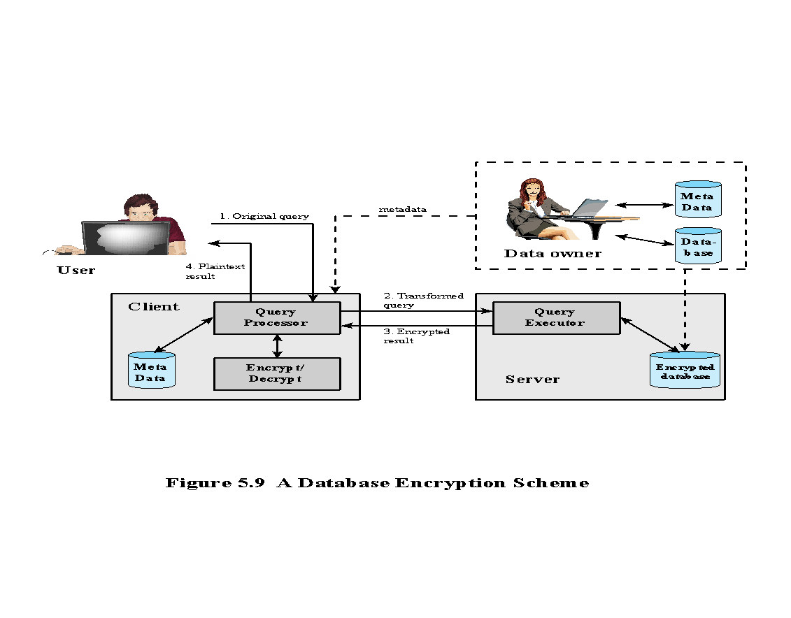
Notes:
A straightforward solution to the security problem in this context is to encrypt
the entire database and not provide the encryption/decryption keys to the service
provider. This solution by itself is inflexible. The user has little ability to access
individual data items based on searches or indexing on key parameters, but rather
would have to download entire tables from the database, decrypt the tables, and
work with the results. To provide more flexibility, it must be possible to work with
the database in its encrypted form.
An example of such an approach, depicted in Figure 5.9 , is reported in
[DAMI05] and [DAMI03]. A similar approach is described in [HACI02]. Four
entities are involved:
• Data owner: An organization that produces data to be made available for
controlled release, either within the organization or to external users.
• User: Human entity that presents requests (queries) to the system. The user
could be an employee of the organization who is granted access to the database
via the server, or a user external to the organization who, after authentication,
is granted access.
Client: Frontend that transforms user queries into queries on the encrypted
data stored on the server.
• Server: An organization that receives the encrypted data from a data owner
and makes them available for distribution to clients. The server could in
fact be owned by the data owner but, more typically, is a facility owned and
maintained by an external provider.
Let us first examine the simplest possible arrangement based on this scenario.
Suppose each individual item in the database is encrypted separately, all using the
same encryption key. The encrypted database is stored at the server, but the server
does not have the key, so the data are secure at the server. Even if someone were
able to hack into the server’s system, all he or she would have access to is encrypted
data. The client system does have a copy of the encryption key. A user at the client
can retrieve a record from the database with the following sequence:
1. The user issues an SQL query for fields from one or more records with a specific
value of the primary key.
2. The query processor at the client encrypts the primary key, modifies the SQL
query accordingly, and transmits the query to the server.
3. The server processes the query using the encrypted value of the primary key and
returns the appropriate record or records.
4. The query processor decrypts the data and returns the results.

Slide 32
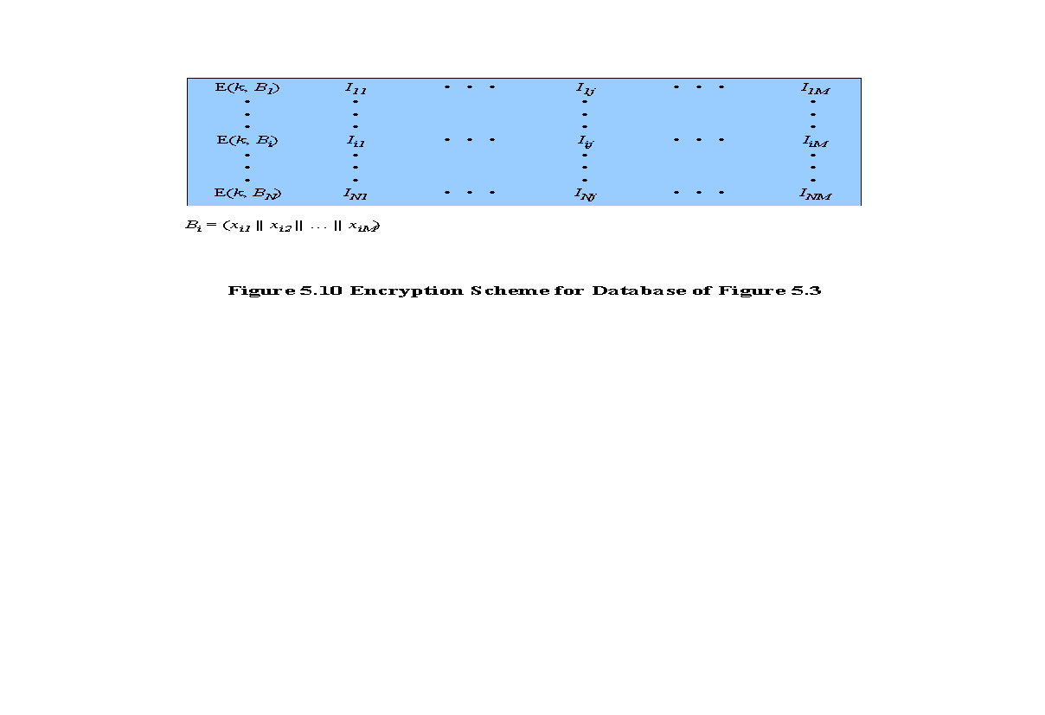
For any attribute, the range of attribute values is divided into a set of non-overlapping
partitions that encompass all possible values, and an index value is assigned to each partition.
Notes:
Each record (row)
of a table in the database is encrypted as a block. Referring to the abstract model
of a relational database in Figure 5.3, each row R_{i} is treated as a contiguous block
B_{i} = (x_{i1} || x_{i2} ||…|| x_{iM} ). Thus, each attribute value in R_{i} , regardless of whether it
is text or numeric, is treated as a sequence of bits, and all of the attribute values
for that row are concatenated together to form a single binary block. The entire
row is encrypted, expressed as E (k, B_{i} ) = E (k, (x_{i1} || x_{i2} ||…|| x_{iM} )). To assist in data
retrieval, attribute indexes are associated with each table. For some or all of the
attributes an index value is created. For each row R_{i} of the unencrypted database, the
mapping is as follows (see Figure 5.10):
(x_{i1}, x_{i2}, … , x_{iM} ) →[E (k, B_{i}), I_{i1}, I_{i2} , … , I_{iM} ]
For each row in the original database, there is one row in the encrypted database.
The index values are provided to assist in data retrieval. We can proceed as
follows. For any attribute, the range of attribute values is divided into a set of non-overlapping
partitions that encompass all possible values, and an index value is
assigned to each partition.

Slide 33
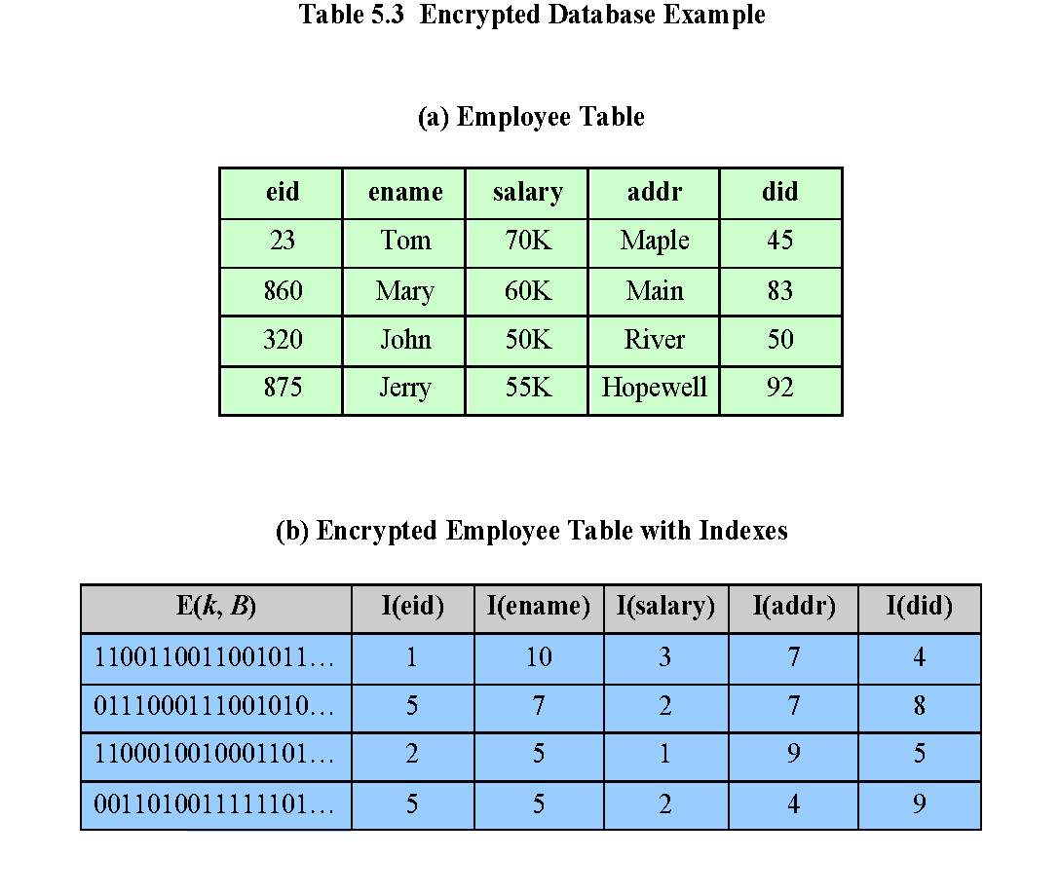
Notes:
Table 5.3 provides an example of this mapping. Suppose employee ID (eid )
values lie in the range [1, 1000]. We can divide these values into five partitions:
[1, 200], [201, 400], [401, 600], [601, 800], and [801, 1000]; then assign index values 1,
2, 3, 4, and 5, respectively. For a text field, we can derive an index from the first letter
of the attribute value. For the attribute ename , let us assign index 1 to values starting
with A or B, index 2 to values starting with C or D, and so on. Similar partitioning
schemes can be used for each of the attributes. Table 5.3b shows the resulting table.
The values in the first column represent the encrypted values for each row. The actual
values depend on the encryption algorithm and the encryption key. The remaining
columns show index values for the corresponding attribute values. The mapping functions
between attribute values and index values constitute metadata that are stored
at the client and data owner locations but not at the server.
This arrangement provides for more efficient data retrieval. Suppose, for
example, a user requests records for all employees with eid 6 < 300. The query processor
requests all records with I (eid ) = 2. These are returned by the server. The query
processor decrypts all rows returned, discards those that do not match the original
query, and returns the requested unencrypted data to the user.
The indexing scheme just described does provide a certain amount of information
to an attacker, namely a rough relative ordering of rows by a given attribute. To
obscure such information, the ordering of indexes can be randomized. For example,
the eid values could be partitioned by mapping [1, 200], [201, 400], [401, 600],
[601, 800], and [801, 1000] into 2, 3, 5, 1, and 4, respectively. Because the metadata are
not stored at the server, an attacker could not gain this information from the server.
Other features may be added to this scheme. To increase the efficiency of accessing
records by means of the primary key, the system could use the encrypted value of
the primary key attribute values, or a hash value. In either case, the row corresponding
to the primary key value could be retrieved individually. Different portions of the
database could be encrypted with different keys, so users would only have access to
that portion of the database for which they had the decryption key. This latter scheme
could be incorporated into a role-based access control system.

Slide 34
Data Center Security
Data center:
An enterprise facility that houses a large number of servers, storage devices, and network switches and equipment
The number of servers and storage devices can run into the tens of thousands in one facility
Generally includes redundant or backup power supplies, redundant network connections, environmental controls, and various security devices
Can occupy one room of a building, one or more floors, or an entire building
Examples of uses include:
Cloud service providers
Search engines
Large scientific research facilities
IT facilities for large enterprises
Notes:
A data center is an enterprise facility that houses a large number of servers, storage
devices, and network switches and equipment. The number of servers and storage
devices can run into the tens of thousands in a single facility. Examples of uses for
these large data centers include cloud service providers, search engines, large scientific
research facilities, and IT facilities for large enterprises. A data center generally
includes redundant or backup power supplies, redundant network connections, environmental
controls (e.g., air conditioning and fire suppression), and various security
devices. Large data centers are industrial scale operations using as much electricity
as a small town. A data center can occupy one room of a building, one or more floors,
or an entire building.

Slide 35
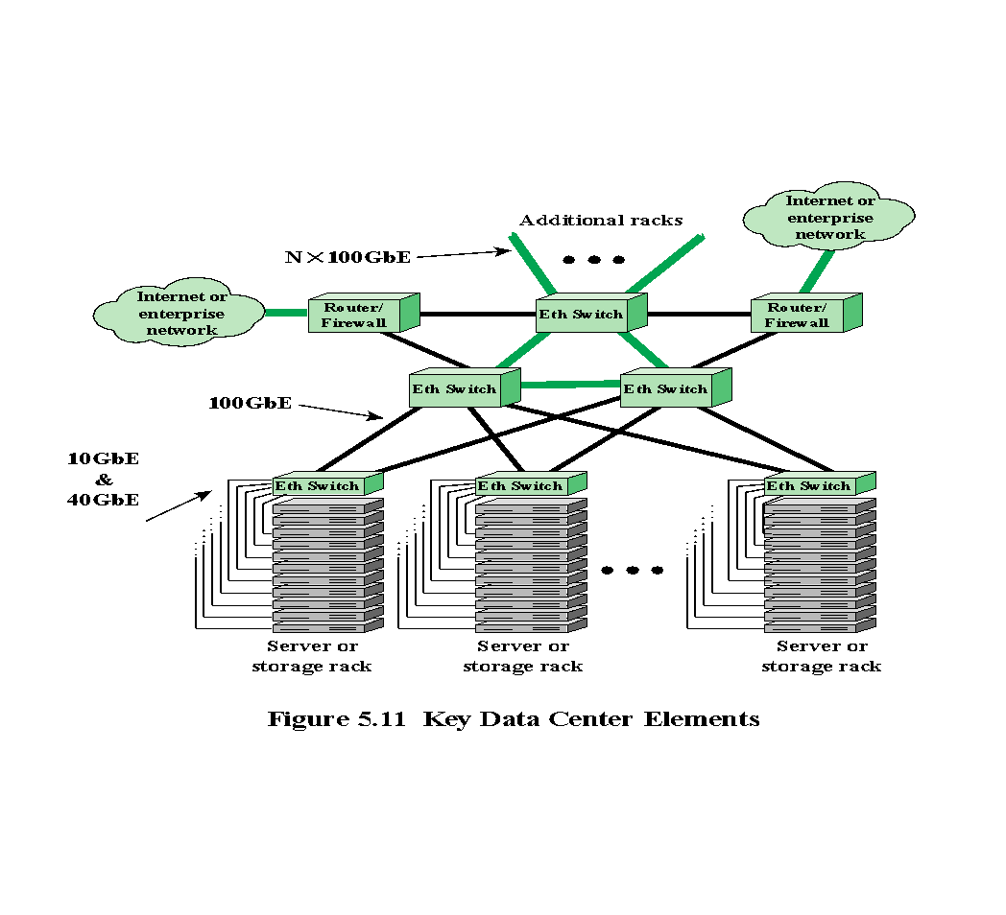
Notes:
Figure 5.11 illustrates key elements of a large data center configuration. Most of the
equipment in a large data center is in the form of stacks of servers and storage modules
mounted in open racks or closed cabinets, which are usually placed in single rows
forming corridors between them. This allows access to the front and rear of each rack
or cabinet. Typically, the individual modules are equipped with 10-Gbps or 40-Gbps
Ethernet ports to handle the massive traffic to and from these servers. Also typically,
each rack has one or two 10, 40 or 100-Gbps Ethernet switches to interconnect all
the servers and provide connectivity to the rest of the facility. The switches are often
mounted in the rack and referred to as top-of-rack (ToR) switches. The term ToR has
become synonymous with server access switch, even if it is not located “top of rack.”
Very large data centers, such as cloud providers, require switches operating at 100
Gbps to support the interconnection of server racks and to provide adequate capacity
for connecting off-site through network interface controllers (NICs) on routers
or firewalls.
Key elements not shown in Figure 5.11 are cabling and cross connects, which
we can list as follows:
• Cross connect: A facility enabling the termination of cables, as well as their
interconnection with other cabling or equipment.
• Horizontal cabling: Any cabling that is used to connect a floor’s wiring closet
to wall plates in the work areas to provide local area network (LAN) drops
for connecting servers and other digital equipment to the network. The term
horizontal is used because such cabling is typically run along the ceiling or
floor.
• Backbone cabling: Run between data center rooms or enclosures and the main
cross-connect point of a building.

Slide 36
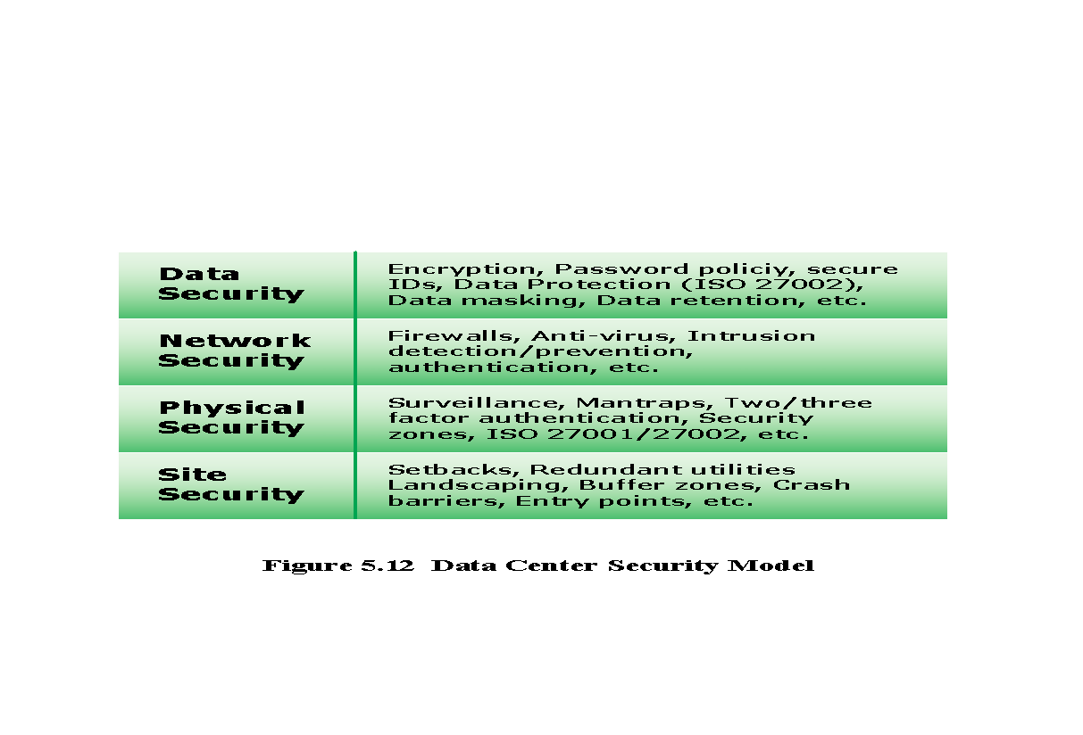
Notes:
All of the security threats and countermeasures discussed in this text are relevant
in the context of large data centers, and indeed it is in this context that the risks
are most acute. Consider that the data center houses massive amounts of data that
are:
• located in a confined physical space.
• interconnected with direct-connect cabling.
• accessible through external network connections, so once past the boundary,
a threat is posed to the entire complex.
• typically representative of the greatest single asset of the enterprise.
Thus, data center security is a top priority for any enterprise with a large data
center. Some of the important threats to consider include the following:
• Denial of service
• Advanced persistent threats from targeted attacks
• Privacy breaches
• Application exploits such as SQL injection
• Malware
• Physical security threats
Figure 5.12 highlights important aspects of data center security, represented
as a four-layer model. Site security refers primarily to the physical security of the
entire site including the building that houses the data center, as well as the use of
redundant utilities. Physical security of the data center itself includes barriers to
entry, such as a mantrap (a double-door single-person access control space) coupled
with authentication techniques for gaining physical access. Physical security can also
include security personnel, surveillance systems, and other measures which will be
discussed in Chapter 16. Network security is extremely important in a facility in
which such a large collection of assets are concentrated in a single place and accessible
by external network connections. Typically, a large data center will employ all
of the network security techniques discussed in this text. Finally, security of the data
itself, as opposed to the systems they reside on, involves techniques discussed in the
remainder of this chapter.

Slide 37
TIA-492
The Telecommunications Industry Association (TIA)
TIA-492 (Telecommunications Infrastructure Standard for Data Centers) specifies the minimum requirements for telecommunications infrastructure of data centers
Includes topics such as:
Network architecture
Electrical design
File storage, backup, and archiving
System redundancy
Network access control and security
Database management
Web hosting
Application hosting
Content distribution
Environmental control
Protection against physical hazards
Power management
Notes:
The Telecommunications Industry Association (TIA) standard TIA-492 (Telecommunications
Infrastructure Standard for Data Centers ) specifies the minimum requirements
for telecommunications infrastructure of data centers. Topics covered include
the following:
• Network architecture
• Electrical design
• File storage, backup, and archiving
• System redundancy
• Network access control and security
• Database management
• Web hosting
• Application hosting
• Content distribution
• Environmental control
• Protection against physical hazards (fire, flood, and windstorm)
• Power management
The standard specifies function areas, which helps to define equipment placement
based on the standard hierarchical design for regular commercial spaces. This
architecture anticipates growth and helps create an environment where applications
and servers can be added and upgraded with minimal downtime. This standardized
approach supports high availability and a uniform environment for implementing
security measures.

Slide 38
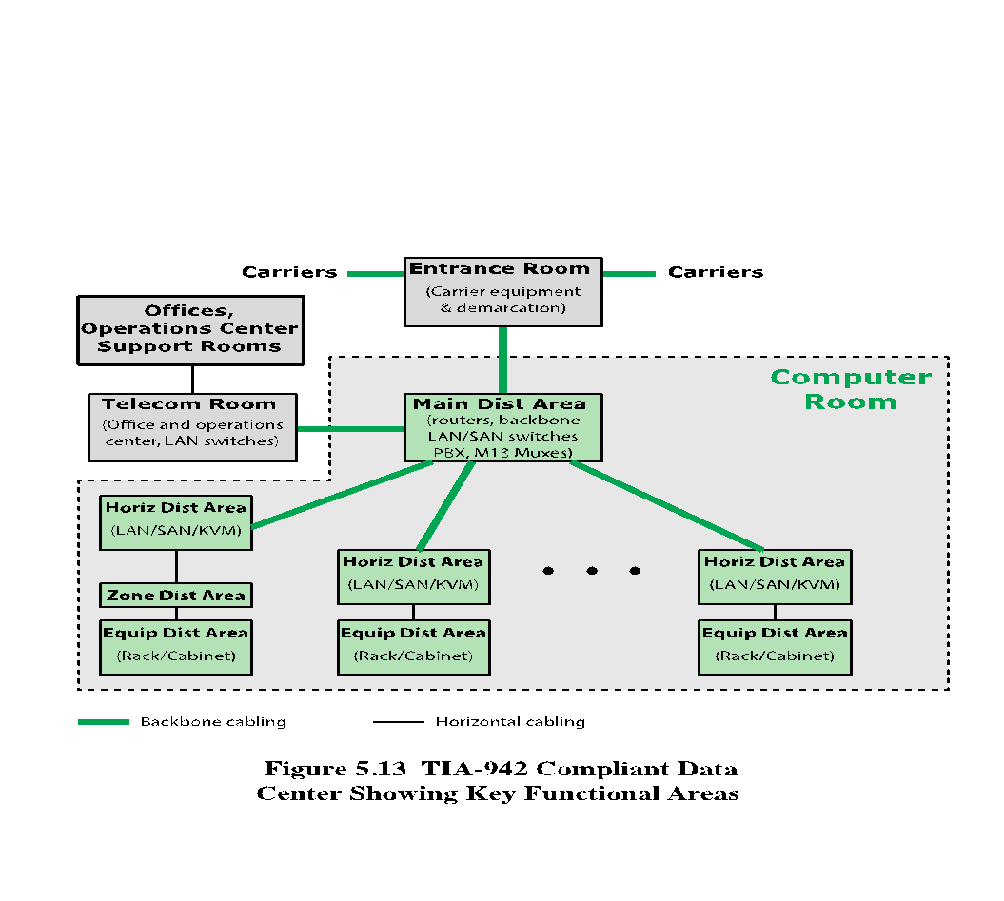
Notes:
TIA-942 specifies that a data center should include the following
functional areas (see Figure 5.13):
• Computer room: Portion of the data center that houses date processing equipment.
• Entrance room: One or more entrance rooms house external network access
provider equipment, plus provide the interface between the computer room
equipment and the enterprise cabling systems. Physical separation of the
entrance room from the computer room provides better security.
• Main distribution area: A centrally located area that houses the main cross-connect
as well as core routers and switches for LAN and SAN (storage area
network) infrastructures.
• Horizontal distribution area (HDA): Serves as the distribution point for horizontal
cabling and houses cross-connects and active equipment for distributing
cable to the equipment distribution area.
• Equipment distribution area (EDA): The location of equipment cabinets and
racks, with horizontal cables terminating with patch panels.
• Zone distribution area (ZDA): An optional interconnection point in the horizontal
cabling between the HDA and EDA. The ZDA can act as a consolidation
point for reconfiguration flexibility or for housing freestanding equipment such
as mainframes.

Slide 39
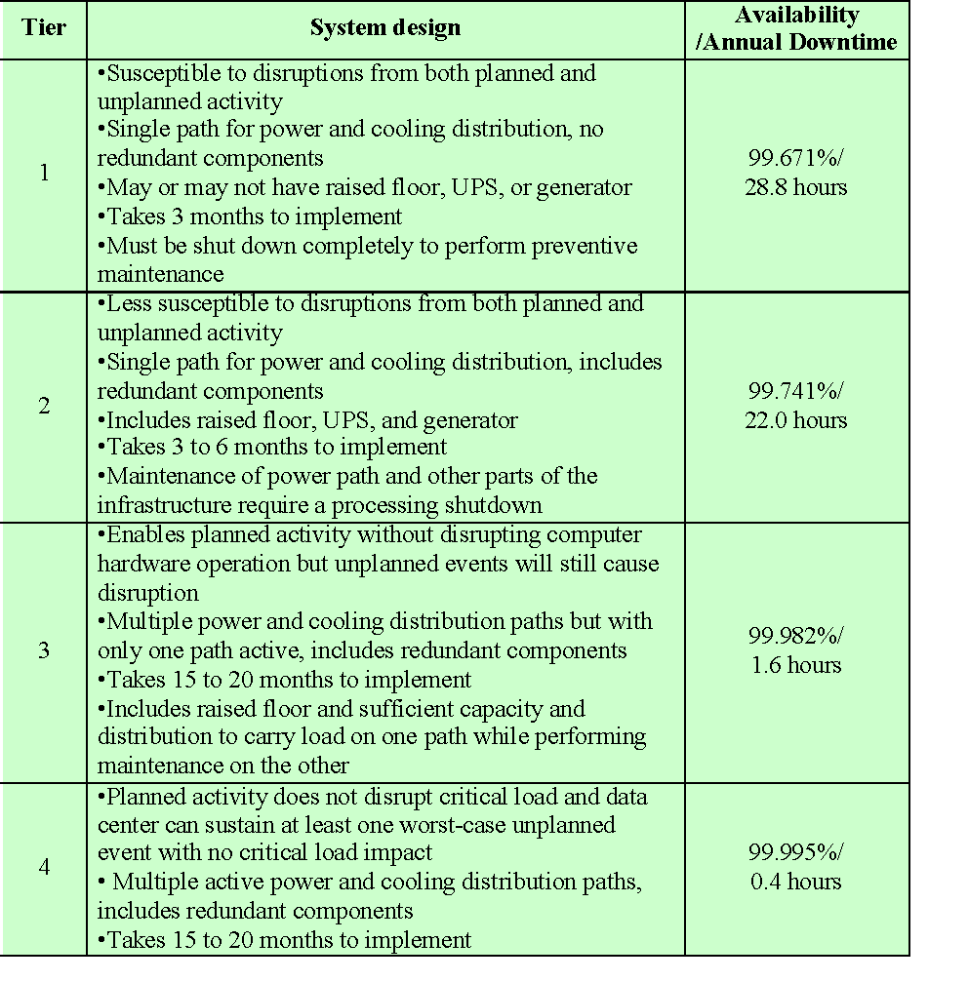
Table 5.4
Data Center Tiers Defined in TIA-942
(Table is on page 177 in textbook)
Notes:
An important part of TIA-942, especially relevant for computer security, is the
concept of tiered reliability. The standard defines four tiers, as shown in Table 5.4.
For each of the four tiers, TIA-942 describes detailed architectural, security, electrical,
mechanical, and telecommunications recommendations such that the higher the tier
is, the higher will be the availability.

Slide 40
Summary
The need for database security
Database management systems
Relational databases
Elements of a relational database system
Structured Query Language
SQL injection attacks
A typical SQLi attack
The injection technique
SQLi attack avenues and types
SQLi countermeasures
Database access control
SQL-based access definition
Cascading authorizations
Role-based access control
Inference
Database encryption
Data center security
Data center elements
Data center security considerations
TIA-492
Notes:
Chapter 5 summary.

